Slide 1
Feature Selection Based Transfer Subspace
Learning for Speech Emotion Recognition
Peng Song and Wenming Zheng
2020 IEEE Transactions on Affective Computing
Date: 2021/09/24
Speaker: Di-Yuan Wang

Slide 2
Outline
Introduction
FSTSL for Cross-Corpus Speech Emotion Recognition
Experiments
Conclusion
Progress Report

Slide 3
Introduction
With the advances in pattern recognition and machine learning techniques, a dozen of statistical algorithms have been developed for emotion classification in recent years.
  Gaussian mixture model (GMM), neural network (NN), support vector machine (SVM),…
Unfortunately, we notice that all these algorithms are conducted on the assumption that the training data and testing data are obtained from the same corpus.

Slide 4
Introduction
Recently, transfer learning has been identified as an effective tool to address this problem by storing the knowledge obtained from the source data and applying this knowledge to the target data [11], [19], [20], [21].
All of these algorithms focus on finding the latent common feature representations to cope with the feature matching problem, and do not take into account the importance of feature selection together.
[11] P. Song, et al., “Cross-corpus speech emotion recognition based on transfer non negative matrix factorization,” Speech Commun., vol. 83, pp. 34–41, 2016.
[19] J. Deng, Z. Zhang, F. Eyben, and B. Schuller, “Autoencoder-based unsupervised domain adaptation for speech emotion recognition,”
IEEE Signal Process. Lett., vol. 21, no. 9, pp. 1068–1072, Sep. 2014.
[20] Y. Zong, W. Zheng, T. Zhang, and X. Huang, “Cross-corpus speech emotion recognition based on domain-adaptive least-
squares regression,” IEEE Signal Process. Lett., vol. 23, no. 5, pp. 585–589, May 2016.
[21] P. Song, “Transfer linear subspace learning for cross-corpus speech emotion recognition,” IEEE Trans. Affective Comput., 2017, doi: 10.1109/TAFFC.2017.2705696.

Slide 5
Introduction
In this paper, we propose a novel cross-corpus speech emotion recognition method, called feature selection based transfer subspace learning (FSTSL).
The central idea of our approach is that the transfer subspace learning and feature selection are conducted together.
In this way, we can learn a projection matrix to map the features from different corpora into a common feature subspace.
Therefore, the obtained common feature representations are more robust, and can have more discriminative power.

Slide 6

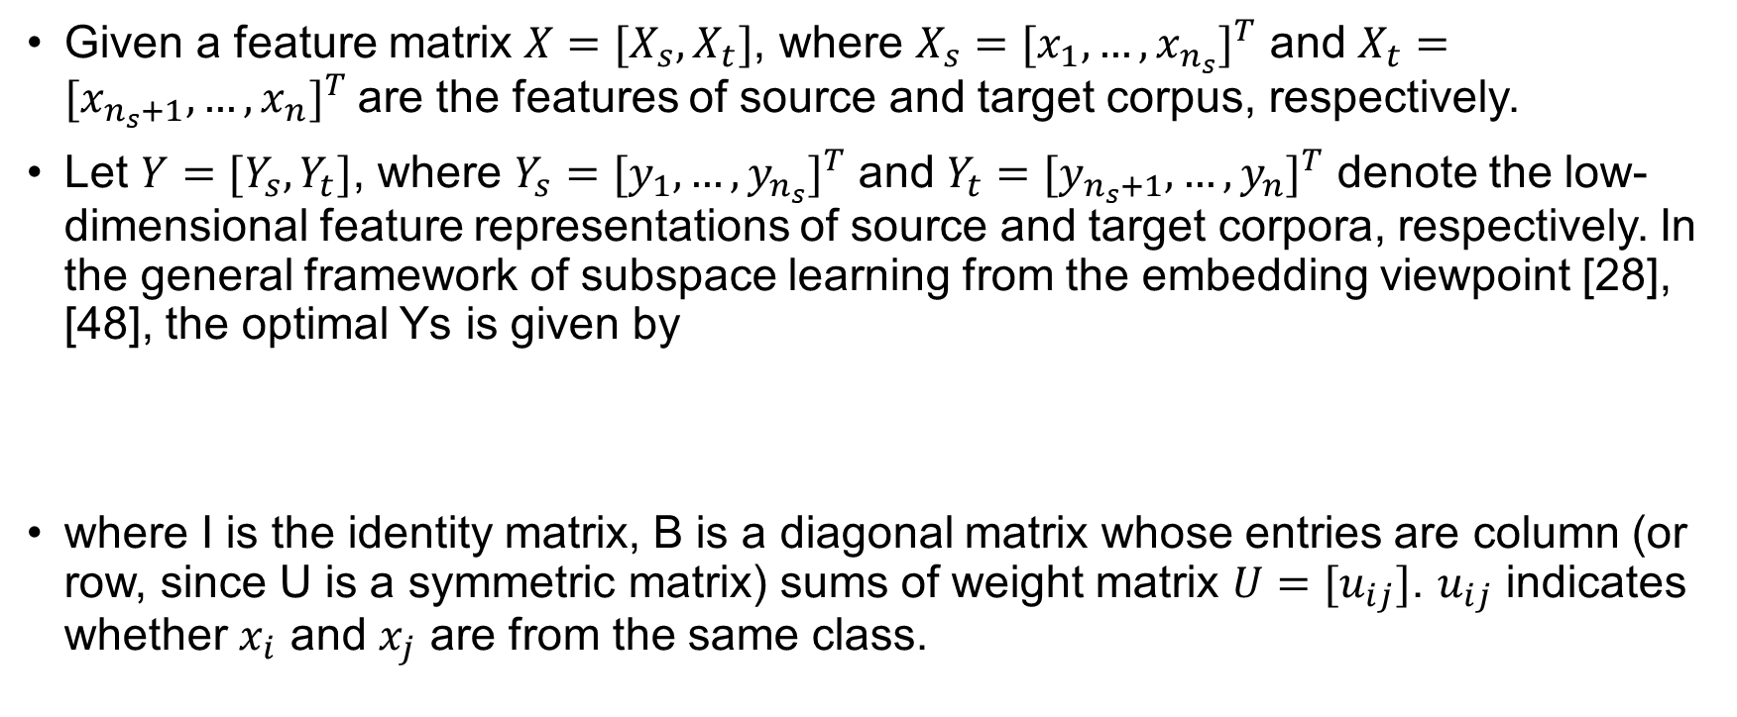
FSTSL for Cross-Corpus Speech Emotion Recognition
Given a feature matrix $X=[X_{s}, X_{t}]$, where $X_{s}={[x_{1},…,x_{n_{s}}]}^{T}$ and $X_{t}={[x_{n_{s}+1},…,x_{n}]}^{T}$are the features of source and target corpus, respectively.
Let $Y=[Y_{s}, Y_{t}]$, where $Y_{s}={[y_{1},…,y_{n_{s}}]}^{T}$ and $Y_{t}={[y_{n_{s}+1},…,y_{n}]}^{T}$ denote the low-dimensional feature representations of source and target corpora, respectively. In the general framework of subspace learning from the embedding viewpoint [28], [48], the optimal Ys is given by
where I is the identity matrix, B is a diagonal matrix whose entries are column (or row, since U is a symmetric matrix) sums of weight matrix $U=[u_{ij}]$. $u_{ij}$ indicates whether $x_{i}$ and $x_{j}$ are from the same class.
[28] S. Yan, D. Xu, B. Zhang, H.-J. Zhang, Q. Yang, and S. Lin, “Graph embedding and extensions: A general framework for dimensionality reduction,” IEEE Trans. Pattern Anal. Mach. Intell., vol. 29, no. 1, pp. 40–51, Jan. 2007.
[48] D. Cai, X. He, and J. Han, “Spectral regression for efficient regularized subspace learning,” in Proc. IEEE Int. Conf. Comput. Vis., 2007, pp. 1–8.

Slide 7
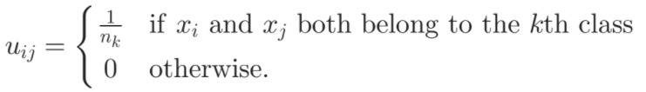
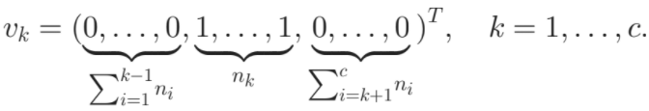
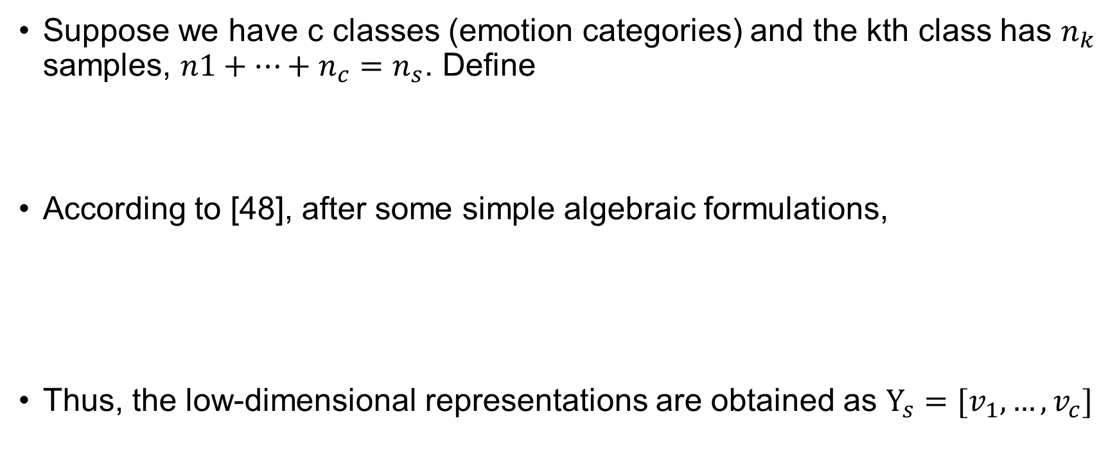
FSTSL for Cross-Corpus Speech Emotion Recognition
Suppose we have c classes (emotion categories) and the kth class has $n_{k}$ samples, $n1+…+n_{c}=n_{s}$. Define
According to [48], after some simple algebraic formulations,
Thus, the low-dimensional representations are obtained as $Y_{s}=[v_{1},…,v_{c}]$
[48] D. Cai, X. He, and J. Han, “Spectral regression for efficient regularized subspace learning,” in Proc. IEEE Int. Conf. Comput. Vis., 2007, pp. 1–8.

Slide 8


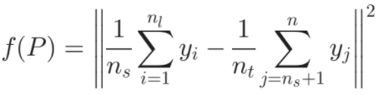
FSTSL for Cross-Corpus Speech Emotion Recognition
Next, we learn a projection matrix P to map the features from different corpora into a common subspace. The objective function can be given as
We adopt the empirical maximum mean discrepancy (MMD) as the distance measurement, which compares the different distributions based on the distance between the sample means of two corpora, and the objective function is reformulated as

Slide 9

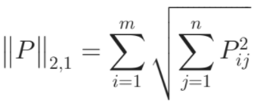
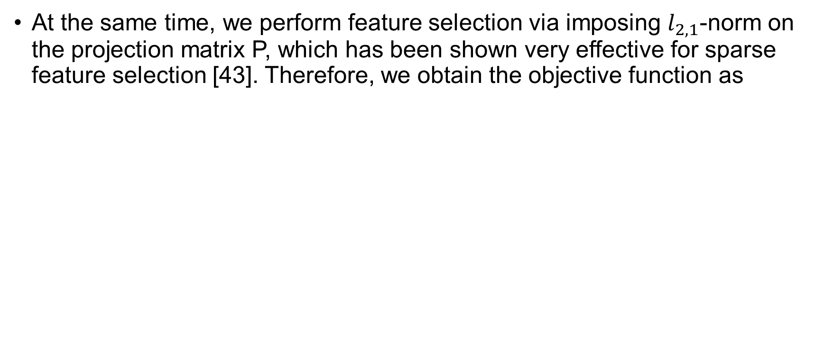
FSTSL for Cross-Corpus Speech Emotion Recognition
At the same time, we perform feature selection via imposing $l_{2,1}$-norm on the projection matrix P, which has been shown very effective for sparse feature selection [43]. Therefore, we obtain the objective function as
[43] F. Nie, H. Huang, X. Cai, and C. H. Ding, “Efficient and robust feature selection via joint l2;1-norms minimization,” in Proc. Int. Conf. Neural Inf. Process. Syst., 2010, pp. 1813–1821.

Slide 10

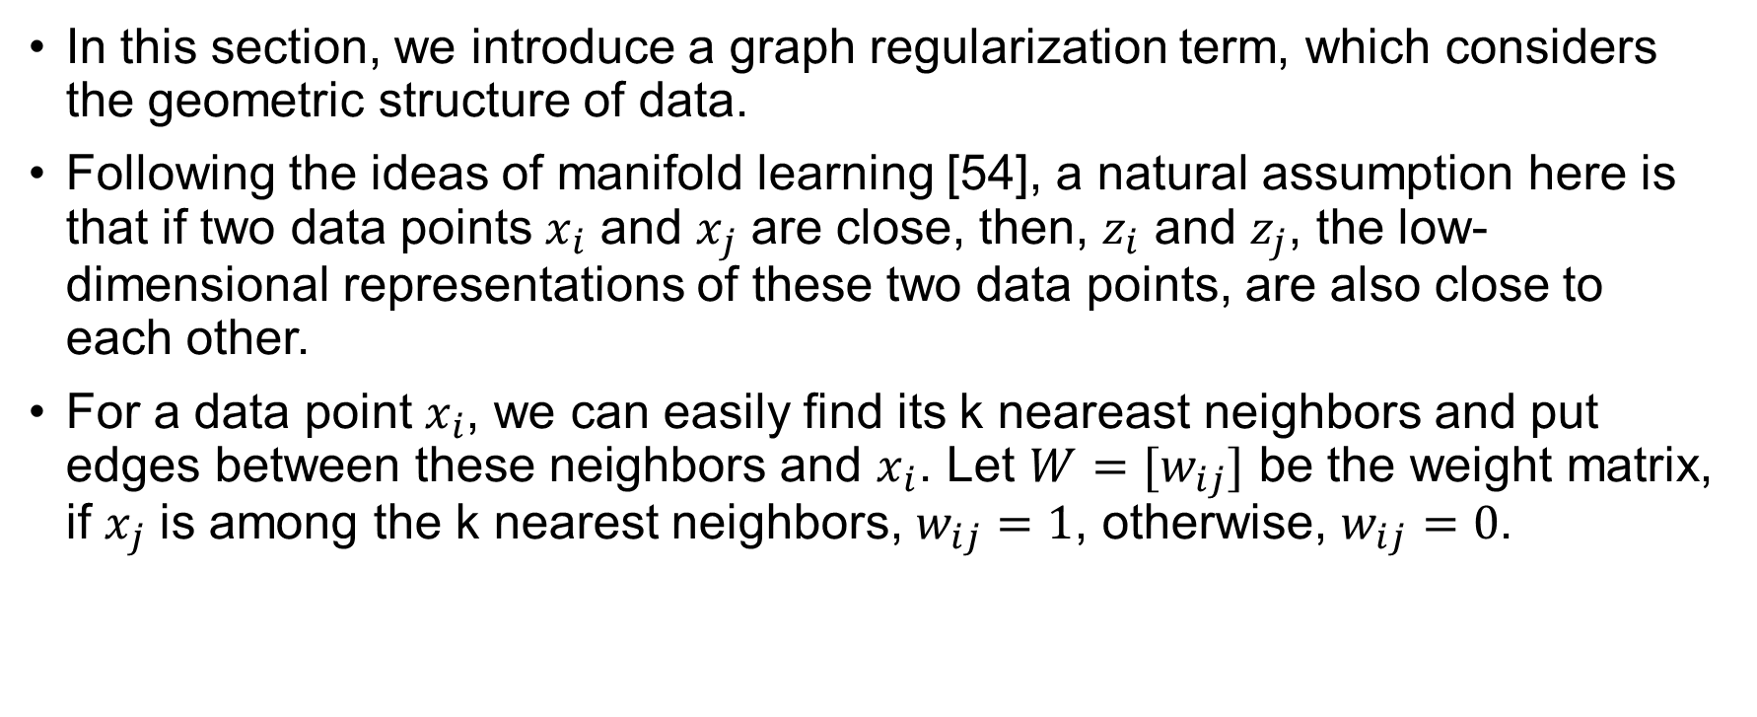
FSTSL for Cross-Corpus Speech Emotion Recognition
In this section, we introduce a graph regularization term, which considers the geometric structure of data.
Following the ideas of manifold learning [54], a natural assumption here is that if two data points $x_{i}$ and $x_{j}$ are close, then, $z_{i}$ and $z_{j}$, the low-dimensional representations of these two data points, are also close to each other.
For a data point $x_{i}$, we can easily find its k neareast neighbors and put edges between these neighbors and $x_{i}$. Let $W=[w_{ij}]$ be the weight matrix, if $x_{j}$ is among the k nearest neighbors, $w_{ij}=1$, otherwise, $w_{ij}=0$.
[54] M. Belkin, P. Niyogi, and V. Sindhwani, “Manifold regularization: A geometric framework for learning from labeled and unlabeled examples,” J. Mach. Learn. Res., vol. 7, no. 11, pp. 2399–2434, 2006.

Slide 11

FSTSL for Cross-Corpus Speech Emotion Recognition
We can obtain our proposed feature selection based transfer subspace learning with graph regularization (FSTSL). The objective function can be written as

Slide 12
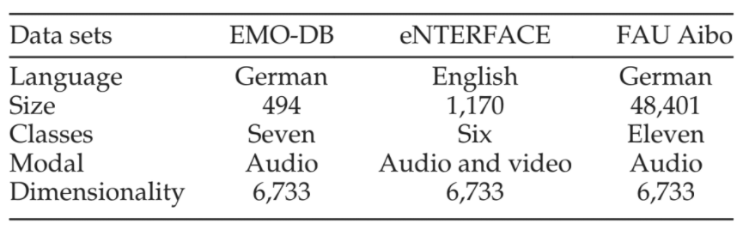
Experiments
[59] F. Eyben, F. Weninger, F. Gross, and B. Schuller, “Recent developments in openSMILE, the Munich open-source multimedia feature extractor,” in Proc. 21st ACM Int. Conf. Multimedia, 2013, pp. 835–838.
[60] F. Eyben and B. Schuller, “openSMILE: The Munich open-source large-scale multimedia feature extractor,” ACM SIGMultimedia Rec., vol. 6, no. 4, pp. 4–13, 2015.
Datasets and Setting
In our experiments, we used the openSMILE toolkit [59], [60] to extract these abovementioned acoustic features.
Since we focus on learning the robust corpus-invariant feature representations, we adopted the popular linear SVM for emotion classification.

Slide 13
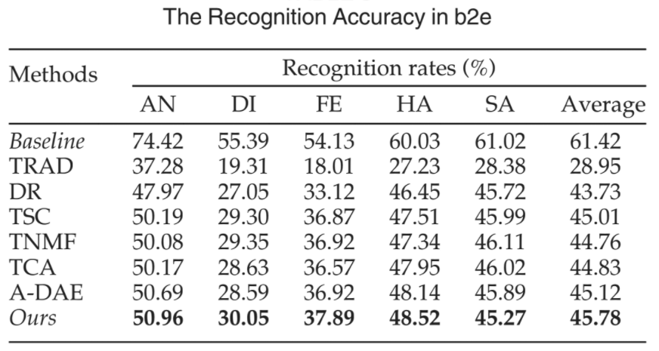
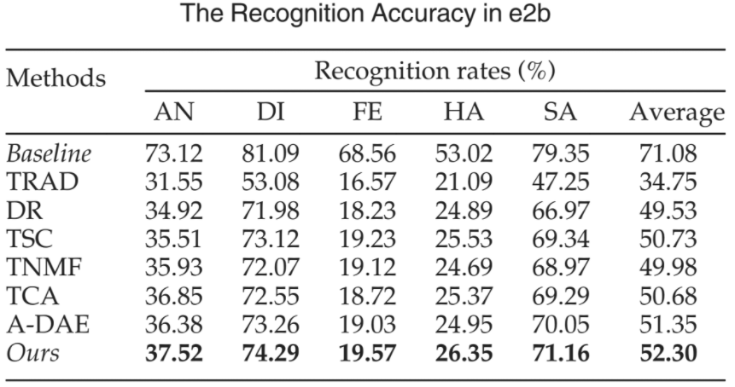
Experiments
Compared with other Algorithms
b: EMO-DB, e: eNTERFACE

Slide 14

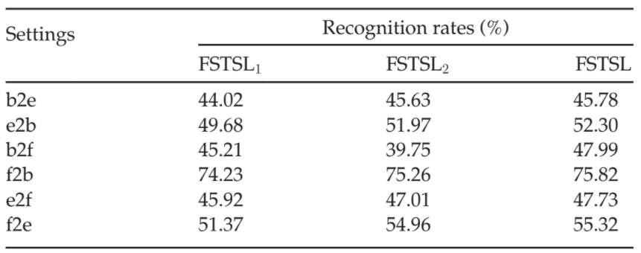
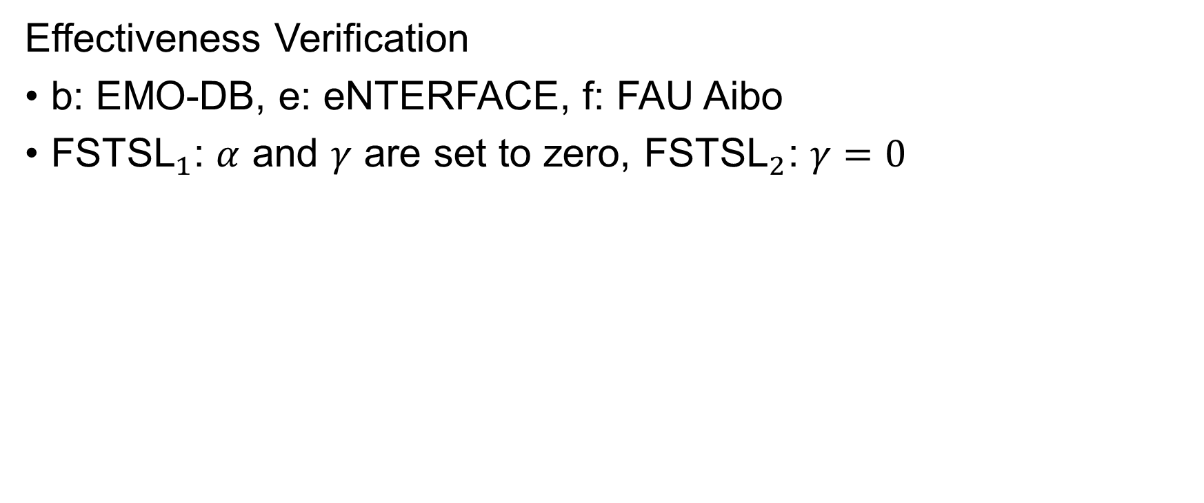
Experiments
Effectiveness Verification
b: EMO-DB, e: eNTERFACE, f: FAU Aibo
${\text{FSTSL}}_{1}$: $α$ and $γ$ are set to zero, ${\text{FSTSL}}_{2}$: $γ=0$

Slide 15
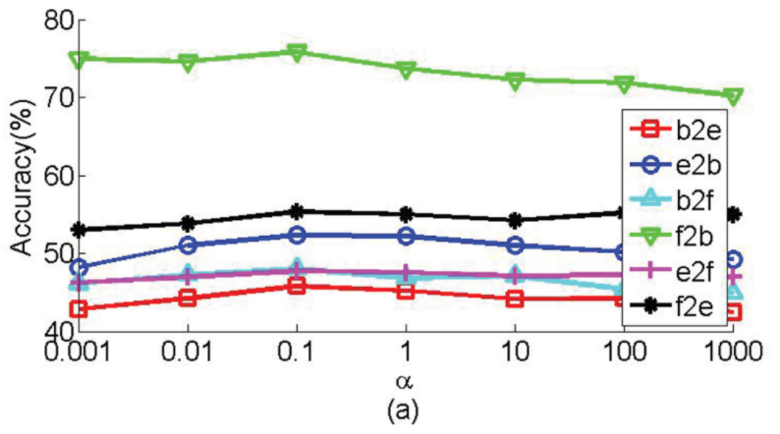
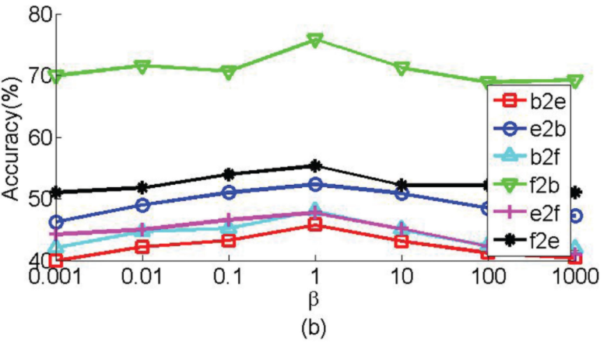
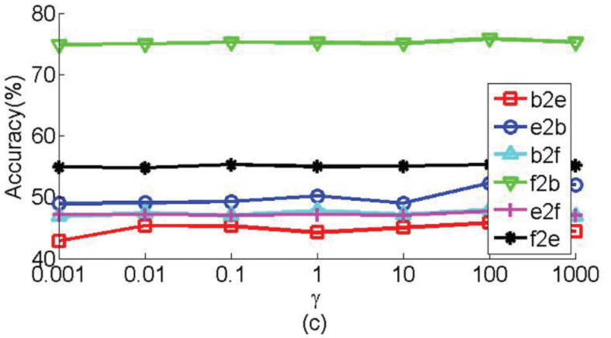
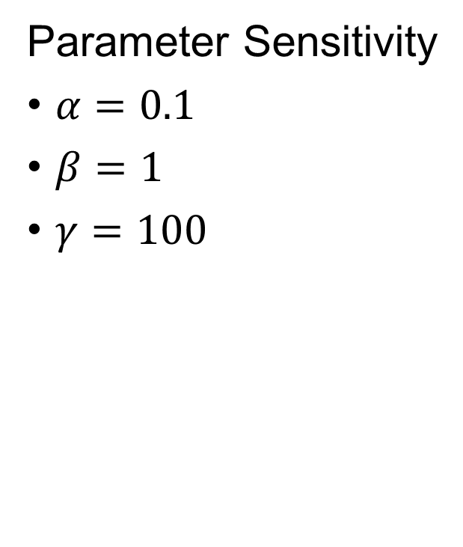
Experiments
Parameter Sensitivity
$α=0.1$
$β=1$
$γ=100$

Slide 16
Conclusion
In this paper, we present a general framework, referred to as feature selection based transfer subspace learning, to address the cross-corpus speech emotion recognition problem.
Furthermore, many existing unsupervised and semi-supervised algorithms can be easily incorporated into the FSTSL framework.
Extensive experiments show that FSTSL is effective and robust for cross-corpus speech emotion recognition tasks and can significantly outperform state-of-the-art transfer learning methods.

Slide 17
Progress Report

Slide 18
Dataset
58 videos from 高榮
Conversational Question Answering
MMSE：0-30
Training：Testing = 9：1

Slide 19
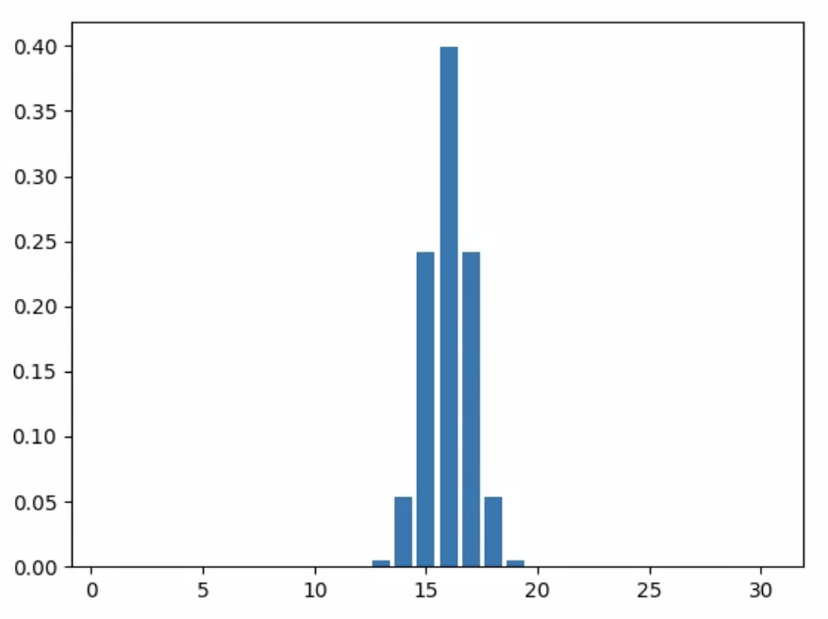
Label Distribution
MMSE Score = 16
Gaussian Distribution
  mean = 16
  std = 1

Slide 20
Model
Late Fusion
Face image
x10
CNN
(VGG16)
MMSE
Speech signal
x10
352-D
Speech features
FCN
Extract 176-d features every 0.5 seconds using openSMILE
Calculate mean and standard deviation of 176-d features
Obtain 352-d（176+176） features for a clip

Slide 21
Result
Visual : Audio | RMSE | Spearman Corr. | Pearson Corr.
10:0 | 6.167344 | 0.21606 | 0.215529
9:1 | 6.112918 | 0.353468 | 0.266559
8:2 | 6.150949 | 0.345085 | 0.252202
7:3 | 5.573271 | 0.439132 | 0.399735
6:4 | 5.34467 | 0.543667 | 0.406921
5:5 | 5.158617 | 0.539115 | 0.477511
4:6 | 4.969626 | 0.606559 | 0.559351
3:7 | 5.008402 | 0.655996 | 0.626604
2:8 | 5.146405 | 0.559687 | 0.520463
1:9 | 5.100084 | 0.562748 | 0.534656
0:10 | 5.100084 | 0.562748 | 0.534656

Slide 22
THANKS

